Slide 1
Advanced Mobile Development

Slide 2
While I’m giving the lecture..
Install all the required apps :
The IDE.
The framework.

Slide 3
First of all…
You may pick up the language / MMVM framework of your choice.

Slide 4
Expected technical specs:
A Master-detail interface (A clickable list of items that navigates to the item’s details)
N-tiers architecture. (Presentation+Logic+Data)
A MVVM Pattern
Implement all CRUD operations (CREATE/READ/UPDATE/DELETE)
A database/ORM (The course uses Realm) with at least two tables and a many-to-one relationship.
You may pick up the language / MVVM framework of your choice.

Slide 5
The Project : some stacks
-Natives : Xamarin, QT, Nativescript...etc.
-Web : Cordova, phonegap ...etc.

Slide 6
MVC design pattern :
Controller
List
Details
View
Create
View
Model
Views
-NB : Dependencies are illustrated via arrows.
-The controller services multiple views (Example : List, Details, Create, Update, Delete) for a given model.
-The controller knows about both the Views and the associated model.
-The View knows only about the model it consumes, nothing about the controller except for the routes.
-The model is ignorant of the controller and the view.

Slide 7
MVVM design pattern :
View
View
Views
ListViewModel
Model
View
DetailsViewModel
View
Views
CreateViewModel
View
View
Views
-NB : Dependencies are illustrated via arrows.
-The ViewModel services only one type of view (Example : List, Details, Create, Update, Delete) for a given model.
-Multiple views may consume a given ViewModel (Example : ItemListViewModel may have an Android view, a iOS view or MacOs View)
-The View knows about both the ViewModel and the model –through the the VM-.
-The ViewModel knows about the model but is ignorant of the View.
-The model is ignorant of the ViewModel and the view.

Slide 8

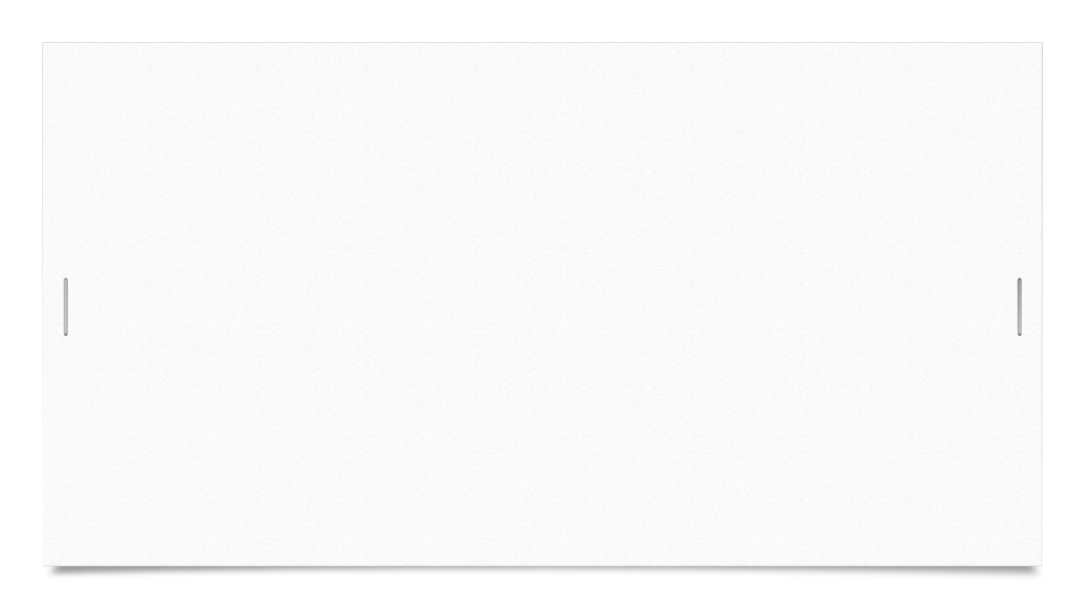
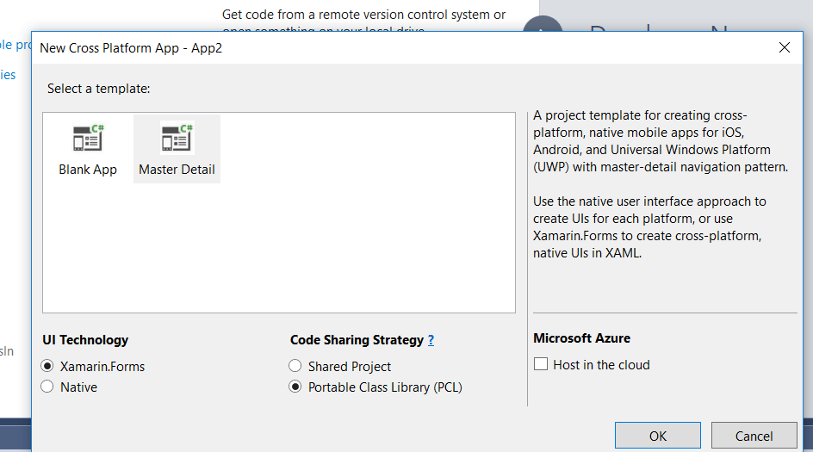

My first project
Create a new project : Visual Studio => File => New project => Cross-Platform => Cross-platform App (Xamarin) => Select Master-Detail && PCL

Slide 9
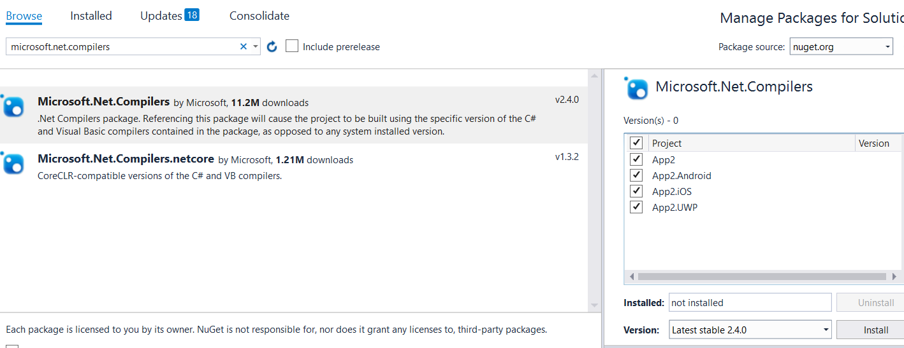
Project may not build
In this case, install the nuget package ‘microsoft.net.compilers’. (Right click on solution => manage nuget packages for solution)

Slide 10
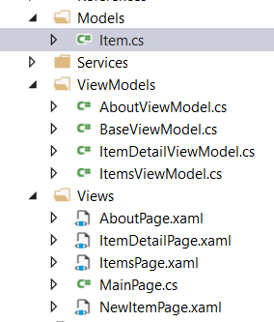
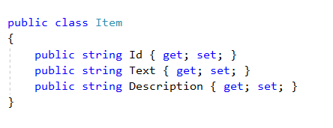
Project Architecture
Models / ViewModels / Views :

Slide 11
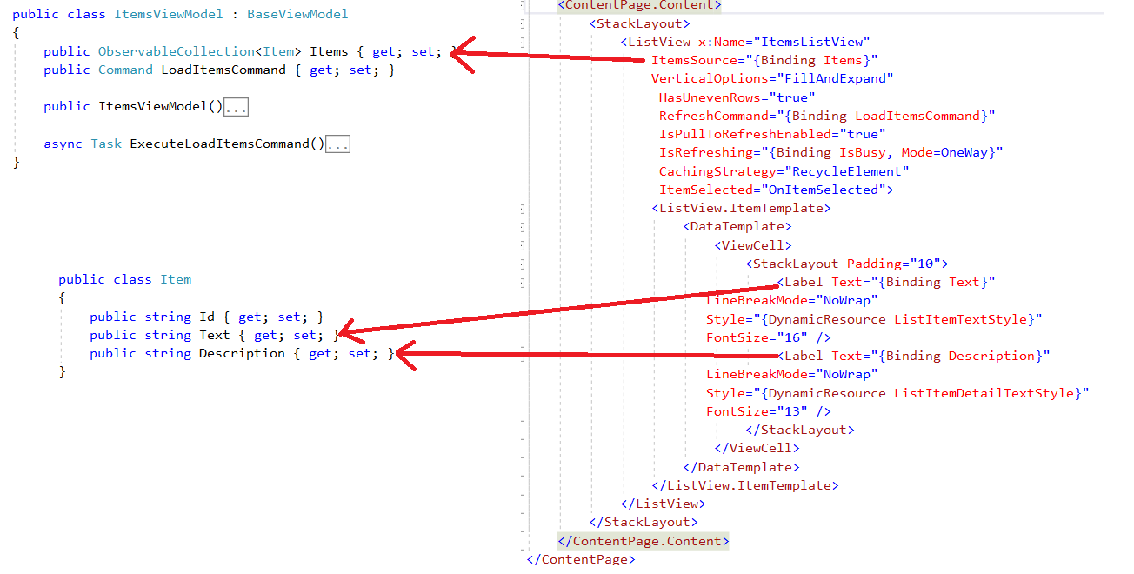
INotifyPropertyChanged

Slide 12
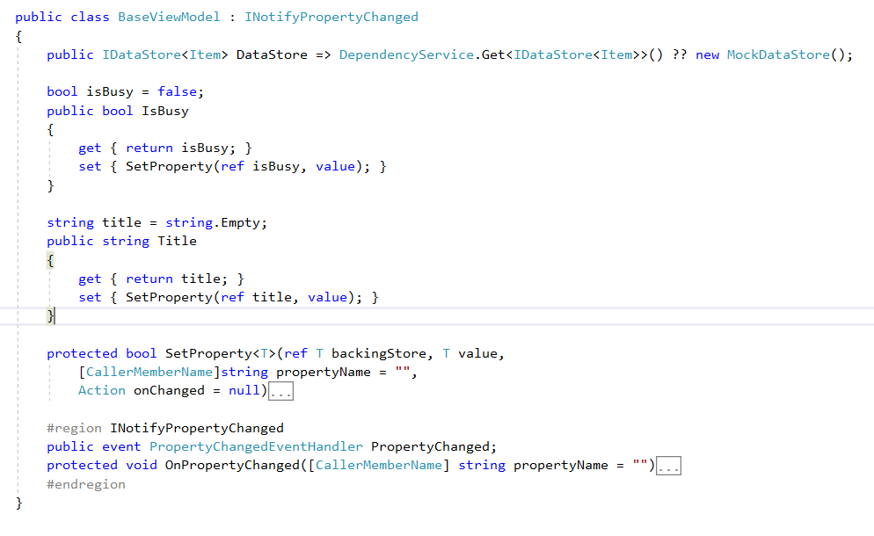
INotifyPropertyChanged

Slide 13
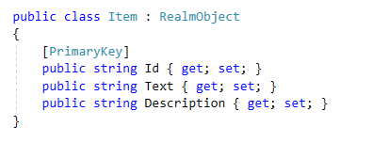
Database
Install the nuget package ‘REALM’.
Annotate your models and inherit from ‘RealmObject’.

Slide 14
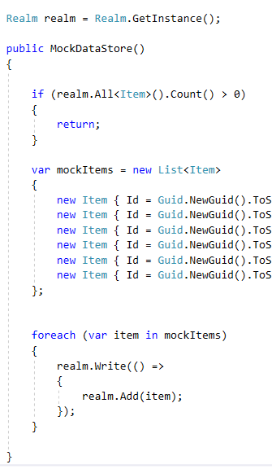
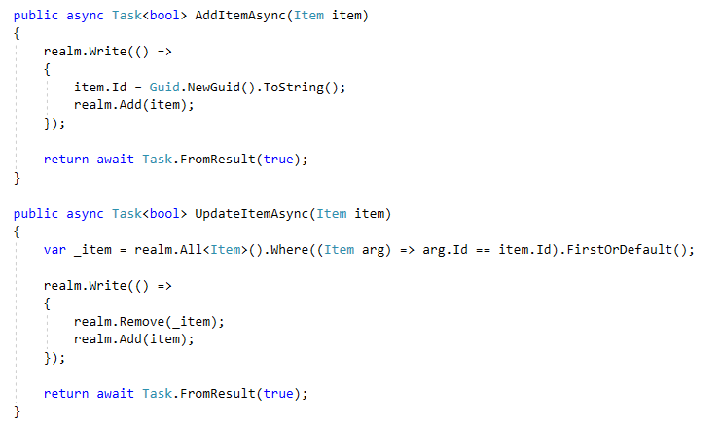
Modify the mock store

